Slide 1
雅思无忧直播课程-阅读
第五讲
主讲老师：朱峰

Slide 2
第五讲教学计划
1、选择题的解题步骤
2、排除法与代入法的综合应用
3、例证题的解题理念
4、简答题的解题技巧

Slide 3
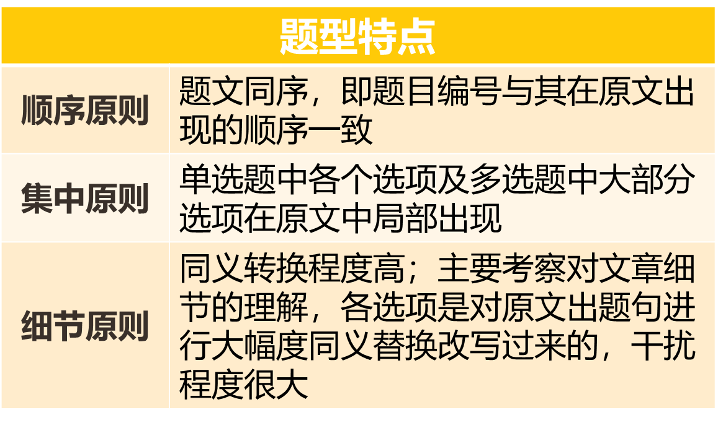
雅思选择题的设计理念（无论是单选还是多选）

Slide 4
选择题的步骤拆分
1.1 定段
1.2 定句
2.1 排除
2.2 检验

Slide 5
选择题的步骤拆分
1.1 定段
顺序出题
整体局部
题干配合选项一起定位

Slide 6
选择题的步骤拆分
1.1 定段
用两篇文章做做自测
不同文章的定位难度不同，但总难度是平衡的

Slide 7
10 Maths textbooks in Japanese schools are
A cheap for pupils to buy.
B well organised and adapted to the needs of the pupils.
C written to be used in conjunction with TV programmes.
D not very popular with many Japanese teachers.
（C8P92）
C Traditional ways of teaching form the basis of the lesson and the remarkably quiet classes take their own notes of the points made and the examples demonstrated. Everyone has their own copy of the textbook supplied by the central education authority, Monbusho, as part of the concept of free compulsory education up to the age of 15. These textbooks are, on the whole, small, presumably inexpensive to produce, but well set out and logically developed. (One teacher was particularly keen to introduce colour and pictures into maths textbooks: he felt this would make them more accessible to pupils brought up in a cartoon culture. ) Besides approving textbooks, Monbusho also decides the highly centralised national curriculum and how it is to be delivered.

Slide 8
D Lessons all follow the same pattern. At the beginning, the pupils put solutions to the homework on the board, then the teachers comment, correct or elaborate as necessary. Pupils mark their own homework: this is an important principle in Japanese schooling as it enables pupils to see where and why they made a mistake, so that these can be avoided in future. No one minds mistakes or ignorance as long as you are prepared to learn from them. After the homework has been discussed, the teacher explains the topic of the lesson, slowly and with a lot of repetition and elaboration. Examples are demonstrated on the board; questions from the textbook are worked through first with the class, and then the class is set questions from the textbook to do individually. Only rarely are supplementary worksheets distributed in a maths class. The impression is that the logical nature of the textbooks and their comprehensive coverage of different types of examples, combined with the relative homogeneity of the class, renders work sheets unnecessary. At this point, the teacher would circulate and make sure that all the pupils were coping well.
11 When a new maths topic is introduced,
A students answer questions on the board.
B students rely entirely on the textbook.
C it is carefully and patiently explained to the students.
D it is usual for students to use extra worksheets.

Slide 9
12 How do schools deal with students who experience difficulties?
A They are given appropriate supplementary tuition.
B They are encouraged to copy from other pupils.
C They are forced to explain their slow progress.
D They are placed in a mixed-ability class.
E It is remarkable that large, mixed-ability classes could be kept together for maths throughout all their compulsory schooling from 6 to 15. Teachers say that they give individual help at the end of a lesson or after school, setting extra work if necessary. In observed lessons, any strugglers would be assisted by the teacher or quietly seek help from their neighbour. Carefully fostered class identity makes pupils keen to help each other - anyway, it is in their interests since the class progresses together.
This scarcely seems adequate help to enable slow learners to keep up. However, the Japanese attitude towards education runs along the lines of 'if you work hard enough, you can do almost anything'. Parents are kept closely informed of their children's progress and will play a part in helping their children to keep up with class, sending them to 'Juku' (private evening tuition) if extra help is needed and encouraging them to work harder. It seems to work, at least for 95 per cent of the school population.

Slide 10
13 Why do Japanese students tend to achieve relatively high rates of success in maths?
A It is a compulsory subject in Japan.
B They are used to working without help from others.
C Much effort is made and correct answers are emphasised.
D There is a strong emphasis on repetitive learning.
F So what are the major contributing factors in the success of maths teaching? Clearly, attitudes are important. Education is valued greatly in Japanese culture; maths is recognised as an important compulsory subject throughout schooling; and the emphasis is on hard work coupled with a focus on accuracy.
Other relevant points relate to the supportive attitude of a class towards slower pupils, the lack of competition within a class, and the positive emphasis on learning for oneself and improving one's own standard. And the view of repetitively boring lessons and learning the facts by heart, which is sometimes quoted in relation to Japanese classes, may be unfair and unjustified. No poor maths lessons were observed. They were mainly good and one or two were inspirational.

Slide 11
14 The use of pesticides has contributed to
A a change in the way ecologies are classified by agroecologists.
B an imbalance of many ecologies around the world .
C the prevention of ecological disasters in the world .
D an increase in the range of ecologies which can be usefully farmed.
（C8P95）
The continuous and reckless use of synthetic chemicals for the control of pests which pose a threat to agricultural crops and human health is proving to be counter-productive. Apart from engendering widespread ecological disorders, pesticides have contributed to the emergence of a new breed of chemical-resistant, highly lethal superbugs.

Slide 12
15 The Food and Agriculture Organisation has counted more than 300 agricultural pests which
A are no longer responding to most pesticides in use.
B can be easily controlled through the use of pesticides.
C continue to spread disease in a wide range of crops.
D may be used as part of bio-control’s replacement of pesticides.
According to a recent study by the Food and Agriculture Organisation (FAO), more than 300 species of agricultural pests have developed resistance to a wide range of potent chemicals. Not to be left behind are the disease-spreading pests, about 100 species of which have become immune to a variety of insecticides now in use.

Slide 13
16 Cotton farmers in Central America began to use pesticides
A because of an intensive government advertising campaign.
B in response to the appearance of new varieties of pest.
C as a result of changes in the seasons and the climate.
D to ensure more cotton was harvested from each crop.
The havoc that the 'treadmill syndrome' can bring about is well illustrated by what happened to cotton farmers in Central America. In the early 1940s, basking in the glory of chemical- based intensive agriculture, the farmers avidly took to pesticides as a sure measure to boost crop yield. The insecticide was applied eight times a year in the mid-1940s, rising to 28 in a season in the mid-1950s, following the sudden proliferation of three new varieties of chemical- resistant pests.

Slide 14
17 By the mid-1960s, cotton farmers in Central America found that pesticides
A were wiping out 50% of the pests plaguing the crops.
B were destroying 50% of the crop they were meant to protect.
C were causing a 50% increase in the number of new pests reported.
D were costing 50% of the total amount they spent on their crops.
By the mid-1960s, the situation took an alarming turn with the outbreak of four more new pests, necessitating pesticide spraying to such an extent that 50% of the financial outlay on cotton production was accounted for by pesticides. In the early 1970s, the spraying frequently reached 70 times a season as the farmers were pushed to the wall by the invasion of genetically stronger insect species.

Slide 15
选择题的步骤拆分
1.2 定句
为什么要定句？
1、很多做错的题，是压根没看清楚题干问的是什么
2、定好了句子，很多无关的内容就不需要看了

Slide 16
10 Maths textbooks in Japanese schools are
A cheap for pupils to buy.
B well organised and adapted to the needs of the pupils.
C written to be used in conjunction with TV programmes.
D not very popular with many Japanese teachers.
These textbooks are, on the whole, small, presumably inexpensive to produce, but well set out and logically developed. (One teacher was particularly keen to introduce colour and pictures into maths textbooks: he felt this would make them more accessible to pupils brought up in a cartoon culture. )

Slide 17
11 When a new maths topic is introduced,
A students answer questions on the board.
B students rely entirely on the textbook.
C it is carefully and patiently explained to the students.
D it is usual for students to use extra worksheets.
After the homework has been discussed, the teacher explains the topic of the lesson, slowly and with a lot of repetition and elaboration. Examples are demonstrated on the board; questions from the textbook are worked through first with the class, and then the class is set questions from the textbook to do individually. Only rarely are supplementary worksheets distributed in a maths class.

Slide 18
12 How do schools deal with students who experience difficulties?
A They are given appropriate supplementary tuition.
B They are encouraged to copy from other pupils.
C They are forced to explain their slow progress.
D They are placed in a mixed-ability class.
E It is remarkable that large, mixed-ability classes could be kept together for maths throughout all their compulsory schooling from 6 to 15. Teachers say that they give individual help at the end of a lesson or after school, setting extra work if necessary. In observed lessons, any strugglers would be assisted by the teacher or quietly seek help from their neighbour. Carefully fostered class identity makes pupils keen to help each other - anyway, it is in their interests since the class progresses together.
This scarcely seems adequate help to enable slow learners to keep up. However, the Japanese attitude towards education runs along the lines of 'if you work hard enough, you can do almost anything'. Parents are kept closely informed of their children's progress and will play a part in helping their children to keep up with class, sending them to 'Juku' (private evening tuition) if extra help is needed and encouraging them to work harder. It seems to work, at least for 95 per cent of the school population.

Slide 19
13 Why do Japanese students tend to achieve relatively high rates of success in maths?
A It is a compulsory subject in Japan.
B They are used to working without help from others.
C Much effort is made and correct answers are emphasised.
D There is a strong emphasis on repetitive learning.
F So what are the major contributing factors in the success of maths teaching? Clearly, attitudes are important. Education is valued greatly in Japanese culture; maths is recognised as an important compulsory subject throughout schooling; and the emphasis is on hard work coupled with a focus on accuracy.
Other relevant points relate to the supportive attitude of a class towards slower pupils, the lack of competition within a class, and the positive emphasis on learning for oneself and improving one's own standard. And the view of repetitively boring lessons and learning the facts by heart, which is sometimes quoted in relation to Japanese classes, may be unfair and unjustified. No poor maths lessons were observed. They were mainly good and one or two were inspirational.

Slide 20
选择题的步骤拆分
2.1 排除
2.2 检验
我们需要知道错误选项为什么错误
更需要了解正确的选项为什么正确

Slide 21
错误选项的设定
无：选项中有一部分原文说了，有一部分没说
反：趋势相反
偏：句子本身正确，但与题干无关
混：每个词原文都有，但根本没有这层关系

Slide 22
错误选项的设定
不要因为不认识正确选项
或者故意把正确答案翻译错而排除

Slide 23
14 The use of pesticides has contributed to
A a change in the way ecologies are classified by agroecologists.
B an imbalance of many ecologies around the world.
C the prevention of ecological disasters in the world .
D an increase in the range of ecologies which can be usefully farmed.
The continuous and reckless use of synthetic chemicals for the control of pests which pose a threat to agricultural crops and human health is proving to be counter-productive. Apart from engendering widespread ecological disorders, pesticides have contributed to the emergence of a new breed of chemical-resistant, highly lethal superbugs.

Slide 24
15 The Food and Agriculture Organisation has counted more than 300 agricultural pests which
A are no longer responding to most pesticides in use.
B can be easily controlled through the use of pesticides.
C continue to spread disease in a wide range of crops.
D may be used as part of bio-control’s replacement of pesticides.
According to a recent study by the Food and Agriculture Organisation (FAO), more than 300 species of agricultural pests have developed resistance to a wide range of potent chemicals. Not to be left behind are the disease-spreading pests, about 100 species of which have become immune to a variety of insecticides now in use.

Slide 25
16 Cotton farmers in Central America began to use pesticides
A because of an intensive government advertising campaign.
B in response to the appearance of new varieties of pest.
C as a result of changes in the seasons and the climate.
D to ensure more cotton was harvested from each crop.
The havoc that the 'treadmill syndrome' can bring about is well illustrated by what happened to cotton farmers in Central America. In the early 1940s, basking in the glory of chemical- based intensive agriculture, the farmers avidly took to pesticides as a sure measure to boost crop yield. The insecticide was applied eight times a year in the mid-1940s, rising to 28 in a season in the mid-1950s, following the sudden proliferation of three new varieties of chemical- resistant pests.

Slide 26
17 By the mid-1960s, cotton farmers in Central America found that pesticides
A were wiping out 50% of the pests plaguing the crops.
B were destroying 50% of the crop they were meant to protect.
C were causing a 50% increase in the number of new pests reported.
D were costing 50% of the total amount they spent on their crops.
By the mid-1960s, the situation took an alarming turn with the outbreak of four more new pests, necessitating pesticide spraying to such an extent that 50% of the financial outlay on cotton production was accounted for by pesticides. In the early 1970s, the spraying frequently reached 70 times a season as the farmers were pushed to the wall by the invasion of genetically stronger insect species.

Slide 27
正确选项的设定
正确答案必然为原文原句的改写（核心单词近义替换）

Slide 28
特殊的例证题
任何例子本身的细节都不应该成为答案
正确答案的两种设定：
1、概述（段落主旨句）
2、功能（支持某人的观点）

Slide 29
特殊的例证题
28 The humpback whale caught off Vancouver Island is mentioned because of
A the exceptional size of its body.
B the way it exemplifies Dollo’s law.
C the amount of local controversy it caused.
D the reason given for its unusual features.
30 The writer mentions the mole salamander because
A it exemplifies what happens in the development of most amphibians.
B it suggests that Raft’s theory is correct.
C it has lost and regained more than one ability.
D its ancestors have become the subject of extensive research.

Slide 30
简答题
完全符合填空题的解题步骤
1、定位可能会比较散，但一定按顺序
2、疑问词往往是最好的定位词

Slide 31
Choose NO MORE THAN TWO WORDS from the passage for each answer.
Write your answers in boxes 8—13 on your answer sheet.
8 Before Perkin’s discovery, with what group in society was the colour purple associated?
9 What potential did Perkin immediately understand that his new dye had?
10 What was the name finally used to refer to the first colour Perkin invented?
11 What was the name of the person Perkin consulted before setting up his own dye works?
12 In what country did Perkin’s newly invented colour first become fashionable?
13 According to the passage, which disease is now being targeted by researchers using synthetic dyes?（C9P20）

Slide 32
Historically, textile dyes were made from such natural sources as plants and animal excretions. Some of these, such as the glandular mucus of snails, were difficult to obtain and outrageously expensive. Indeed, the purple colour extracted from a snail was once so costly that in society at the time only the rich could afford it. Further, natural dyes tend to be muddy in hue and fade quickly. It was against this backdrop that Perkin’s discovery was made.

Slide 33
Perkin quickly grasped that his purple solution could be used to colour fabric, thus making it the world’s first synthetic dye. Realising the importance of this breakthrough, he lost no time in patenting it. But perhaps the most fascinating of all Perkin’s reactions to his find was his nearly instant recognition that the new dye had commercial possibilities.

Slide 34
Perkin originally named his dye Tyrian Purple, but it later became commonly known as mauve (from the French for the plant used to make the colour violet). He asked advice of Scottish dye works owner Robert Pullar, who assured him that manufacturing the dye would be well worth it if the colour remained fast (i.e. would not fade) and the cost was relatively low. So, over the fierce objections of his mentor Hofmann, he left college to give birth to the modern chemical industry.

Slide 35
With the help of his father and brother, Perkin set up a factory not far from London. Utilising the cheap and plentiful coal tar that was an almost unlimited byproduct of London’s gas street lighting, the dye works began producing the world’s first synthetically dyed material in 1857. The company received a commercial boost from the Empress Eugenie of France, when she decided the new colour flattered her. Very soon, Mauve was the necessary shade for all the fashionable ladies in that country. Not to be outdone, England’s Queen Victoria also appeared in public wearing a mauve gown, thus making it all the rate in England as well. The dye was bold and fast, and the public clamoured for more. Perkin went back to the drawing board.

Slide 36
Although Perkin’s fame was achieved and fortune assured by his first discovery, the chemist continued his research. Among other dyes he developed and introduced were aniline red (1859) and aniline black (1863) and, in the late 1860s, Perkin’s synthetic dye discoveries had outcomes far beyond the merely decorative. The dyes also became vital to medical research in many ways. For instance, they were used to stain previously invisible microbes and bacteria, allowing researchers to identify such bacilli as tuberculosis, cholera, and anthrax. Artificial dyes continue to play a crucial role today. And, in what would have been particularly pleasing to Perkin, their current use is in the search for a vaccine against malaria.

Slide 37
作业
剑6 T3 P1 P66 Q10-13（选择题）
剑6 T1 P1 P21 Q12-13（简答题）

